Slide 1
PYTHON FUNCTIONS
Presented By
Geethu

Slide 2
Definition
A function is a block of code that performs a specific task. There are two types of functions,
Standard library functions
Ex: print()
User defined functions
Ex: sum1()...

Slide 3
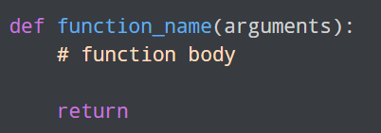
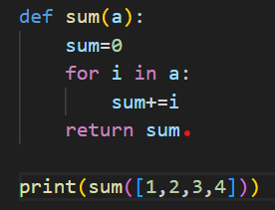
Declaration

Slide 4
Function Argument
An argument is a value accepted by function.
Argument with default values
Keyword argument
Arbitrary argument
Arbitrary keyword argument

Slide 5
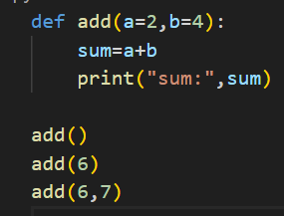
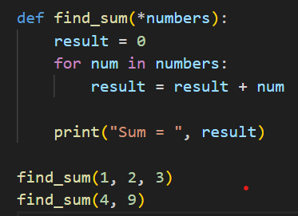
Ex: Arbitrary
Ex :Default

Slide 6
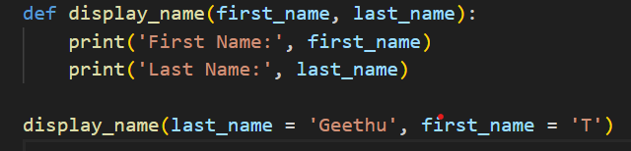
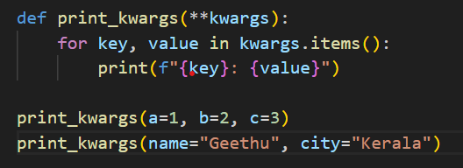
Ex: Keyword
Ex: Keyword Arbitrary

Slide 7
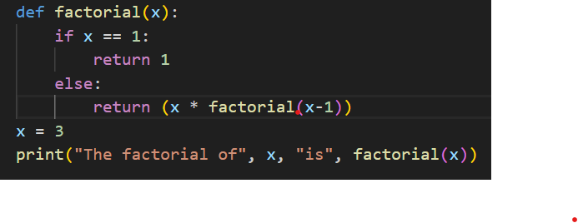
Recursive function
A function which calls itself is known as recursive function.

Slide 8

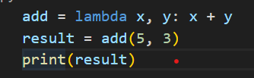
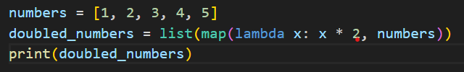
Lambda function
Lambda function is a special type of function without function name.

Slide 9
Higher Order functions
A function that operate with another function or it contains other functions as a parameter,returns a function as output.
Ex: Filter()
Map()
Reduce()

Slide 10
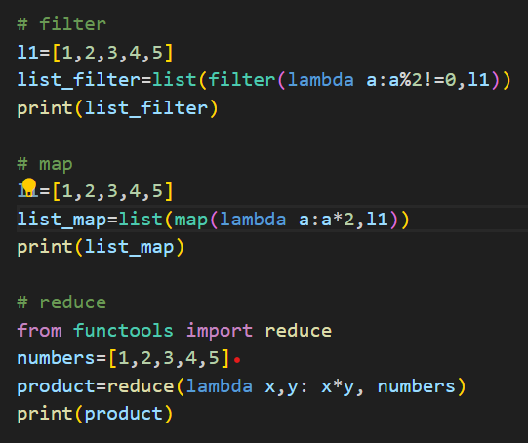

Slide 11
Scope
A variable scope specifies the region where we can access a variable.based on scope, we have
Global
Local
Nonlocal

Slide 12
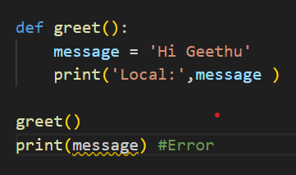
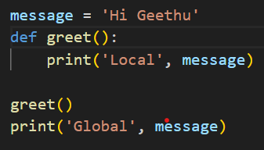
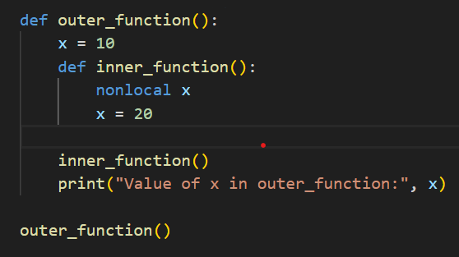
Ex: Local
Ex: Global
Ex: Nonlocal

Slide 13
THANK YOU

